Slide 1
UD5: INFERENCE
Part 1: Distributions in sampling
Part 2: Inference about one population
Comparison of 2 populations
Part 3: ANOVA (Analysis of Variance)
Part 4: Regression
1

Slide 2

UD 5 part 3
ANOVA
ANALYSIS OF VARIANCE
2

Slide 3
One computer factory has to purchase the batteries for a new model of laptop. There are three possible battery suppliers: S1, S2 and S3.
In order to determine which one is more convenient, the company purchases 10 batteries from each supplier and determines the following parameter:
1 factor (supplier) with 3 variants:
S1
S2
S3
23
35
50
28
36
43
21
29
36
RESULTS OBTAINED
(time of battery operation, months, until the battery lasts 2 hours)
27
40
34
35
43
45
41
49
52
37
51
52
30
28
43
32
50
44
3
36
52
34

Slide 4
61
Which supplier should we choose?
51
time
41
31
H₀: m₁ = m₂ = m₃
21
1
2
3
supplier
Average: 31 41.3 43.3
Price: 70 80 85
Is there enough evidence to affirm that batteries from supplier 3 last longer and therefore would be more appropriate despite their higher price?
Would it be possible to analyze these data by comparing S1 vs S2 ; S1 vs S3 ; S2 vs S3 ?
If we had 5 suppliers, how many pairs should we compare?
4
THE COMPARISON OF ALL POSSIBLE PAIRS IS NOT RECOMMENDED

Slide 5
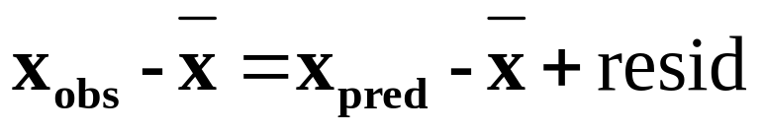
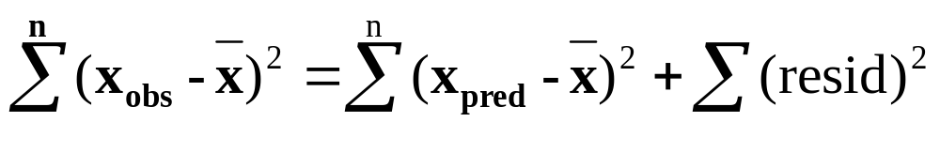
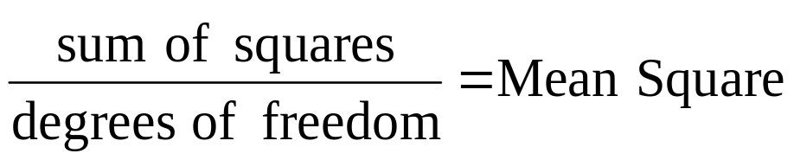
ANalysis Of VAriance (ANOVA)
Developed in ~1930 by R. A. Fisher
POWERFUL TOOL TO STUDY OF THE EFFECT OF ONE OR MORE FACTORS ON THE MEAN OF ONE VARIABLE
INTUITIVE IDEA OF ANOVA
Residual = X_{observed} – X_{predicted}
X_{observed} = X_{predicted} + residual
Average of all data
Sum of Squares (SS): SS_{TOTAL} = SS_{FACTOR} + SS_{RESIDUAL}
SS / d.f. = MS
5
d.f._{TOTAL} = d.f._{FACTOR} + d.f._{RESIDUAL}

Slide 6
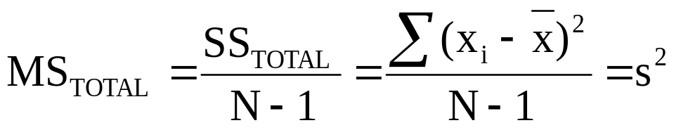
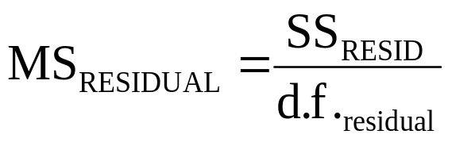
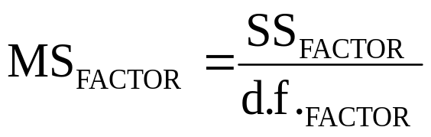
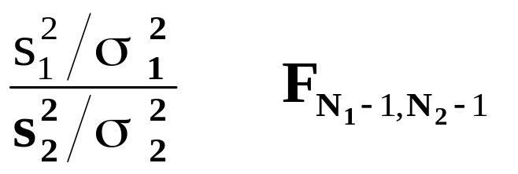
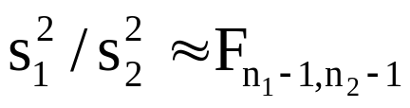
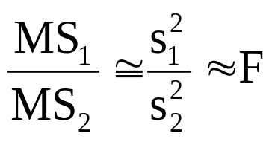
MS = SS / d.f.
Total degrees of freedom = total number of data - 1
Degrees Fr._{FACTOR} = Number of variants - 1
Comparison of variance of two Normal populations:
Assuming σ²₁ = σ²₂ :
∼
Mean Square is more or less a variance:
6
(a measure of data variability)

Slide 7




F - TEST
Are there differences between the mean time of battery operation in the batteries from the 3 suppliers?
NULL HYPOTHESIS:
H₀ : m₁ = m₂ = m₃ (there are no differences)
IF THE NULL HYPOTHESIS IS TRUE:
1) SAMPLE AVERAGES , AND WILL BE “SIMILAR”
(AND THEREFORE “SIMILAR” ALSO TO THE GRAND MEAN)
2) SUM OF SQUARES OF THE FACTOR WILL BE “SMALL”,
BUT... WHAT SHOULD BE CONSIDER AS “SMALL” ?
3) MS_{residual} IS AN ESTIMATION OF σ² (σ²₁ = σ²₂ = σ²₃)
4) MS_{factor} IS ALSO AN ESTIMATOR OF σ² , INDEPENDENT
FROM MS_{RESID}, AND CONSEQUENTLY:
7
F-ratio = (MS_{factor} / MS_{residual}) = S_{f} ² / S_{r} ² ∼ F_{2 , 27}

Slide 8
T: time of battery operation
T₁ ~ N(m₁ , σ²)
T₂ ~ N(m₂ , σ²)
T₃ ~ N(m₃ , σ²)
SS_{RES}
MS_{FACTOR}
S_{r}² =
= MS_{RES}
(estimation of σ²)
= F-ratio
d.f._{res}
MS_{RESID}
- IF THERE ARE NO DIFFERENCES AMONG SUPPLIERS (m₁ = m₂ = m₃)
SS_{factor}
MS_{FACTOR}
= MS_{FACTOR} =
S_{f}²
≈ 1
(estimation of σ²)
d.f._{factor}
MS_{RESID}
- IF THERE ARE DIFFERENCES AMONG SUPPLIERS:
SS_{factor}
= MS_{FACT} =
F-ratio tends
to be > 1
S_{f}²
will tend to be higher than σ²
d.f._{factor}
IF H₀ IS NOT TRUE (if there are differences in the mean of at least one supplier): F-ratio will be higher (in average) than F_{2, 27}
F_{2 , 27}
MS_{factor}
F-ratio =
MS_{residual}
0.05
8
Accept H₀
Reject H₀
F_{tables}(0.05)=3.35

Slide 9
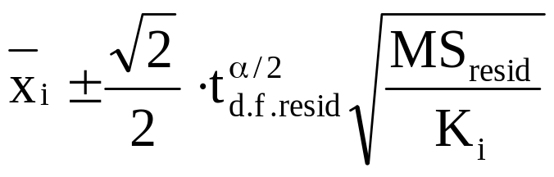
LSD INTERVALS FOR MEAN COMPARISON
IF THE F-TEST HAD RESULTED STATISTICALLY SIGNIFICANT:
Accept H₁ (at least one m_{i} is different from the rest)
Reject H₀ ( m₁ = m₂ = m₃ )
WHICH ONE IS DIFFERENT ?
OBTAIN LSD INTERVALS (“LEAST SIGNIFICANCE DIFFERENCE”) FOR THE SAMPLE AVERAGE OF EACH SUPPLIER
α/2
α/2
K: Number of repetitions from supplier i
-t(α/2)
t(α/2)
t^{α/2}_{dfres}: critical value from t- table
THE DIFFERENCE BETWEEN TWO MEANS WILL BE SIGNIFICANT IF THEIR LSD INTERVALS DO NOT OVERLAP...
... OTHERWISE, THERE IS ENOUGH EVIDENCE TO SAY THAT THE DIFFERENCE IS STATISTICALLY SIGNIFICANT
ATTENTION: LSD INTERVALS ARE NOT CONFIDENCE
INTERVALS FOR THE MEAN !!
9

Slide 10



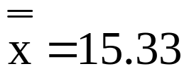
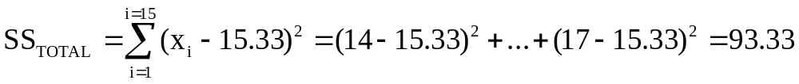
ANOVA with 1 Factor (3 variants)
(example of laptop batteries) T: time of battery operation
3 possible battery suppliers: S_{A}, S_{B} and S_{C}.
Time - batteries from S_{A}:
14 11 15 12 13
Time - batteries from S_{B}:
16 13 17 15 14
Time - batteries from S_{C}:
18 16 19 20 17
Are the differences statistically significant (α=0.05)?
H₀: m_{A} = m_{B} = m_{C}
Grand mean:
10
SS_{RESIDUAL} = SS_{TOTAL} - SS_{FACTOR}

Slide 11
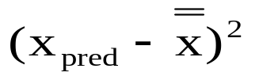
ANOVA with 1 Factor (3 variants)
factor X_{obs}
X_{pred}
A
B
C
14 11 15 12 13
16 13 17 15 14
18 16 19 20 17
13
15
18
5 · (13 - 15.33)²
5 · (15 - 15.33)²
5 · (18 - 15.33)²
sum:
63.33 = SS_{FACTOR}
Source
S.S.
D.F.
M.S.
F_{ratio}
FACTOR
RESIDUAL
63.33
2
31.67
12.67
30
12
2.5
TOTAL
93.33
14
F_{2, 12}
* Critical value from table:
F_{2 ,12} (0.05) = 3.89 < 12.67
12.67
Reject H₀
11
3.89

Slide 12
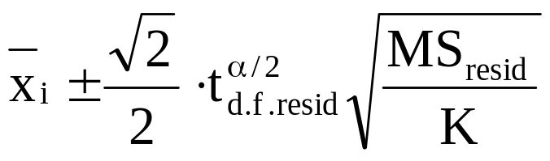
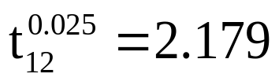
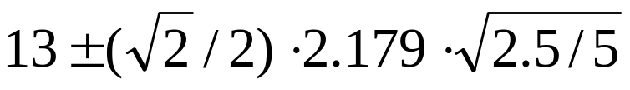



ANOVA with 1 Factor (3 variants)
H₁: (m_{A} = m_{B}) ≠ m_{C}
Reject H₀
H₀: m_{A} = m_{B} = m_{C}
H₁: (m_{A} = m_{C}) ≠ m_{B}
H₁: m_{A} ≠ m_{B} ≠ m_{C}
H₁: (m_{B} = m_{C}) ≠ m_{A}
At least one mean is significantly different from the rest
Least Significant Differences (LSD) intervals:
K: number of data used to calculate x_{i}
D.F.res: Residual degrees of freedom
LSD_{A}:
[ 11.91, 14.09 ]
LSD_{B}:
[ 13.91, 16.09 ]
Solution:
(m_{A} = m_{B}) < m_{C}
LSD_{C}:
[ 16.91, 19.09 ]
12
A
B
C

Slide 13
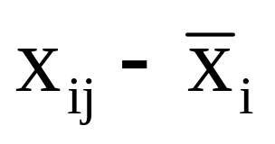
ANALYSIS OF RESIDUALS
This is an important part of ANOVA and regression.
Any statistical analysis with real data has to be always completed with the analysis of residuals.
RESIDUAL of observation ij =
Residuals reflect the effect in the response variable of all factors not controlled in the experiment.
In ANOVA, studying the residuals allows us to check if:
- Data are normally distributed (with no outliers)
- The population variance of all suppliers is the same
13

Slide 14
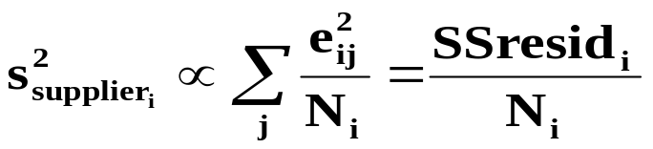
STUDY OF EFFECTS OVER VARIANCES
Is the variance of data from all suppliers the same?
T₁ = N(m₁ , σ₁²)
T₂ = N(m₂ , σ₂²)
T₃ = N(m₃ , σ₃²)
H₀: σ₁² = σ₂² = σ₃²
QUESTION:
Is there any relationship between the average of squared residuals from one supplier and the variance obtained for that supplier?
ANOVA is very powerful to study differences in the mean of a variable among different populations
EASY WAY TO STUDY EFFECTS OVER DISPERSION:
1.- Conduct one ANOVA to study effects over the mean.
2.- Calculate the residual of each observation.
3.- Save the squared residuals
4.- Conduct one ANOVA considering as response variable: SQUARED RESIDUALS
14

Slide 15
ANOVA WITH A QUANTITATIVE FACTOR
One experiment has been conducted to obtain the optimum pesticide dose (tested at 3 levels) for the control of a certain insect. The response variable measured is related to the pest population. RESULTS:
Dose = 3
Dose = 6
Dose = 9
0.31
0.20
0.20
0.35
0.22
0.19
0.39
0.21
0.22
0.37
0.25
0.16
0.33
0.21
0.17
0.41
0.19
0.24
What dose would you recommend to minimize Y?
15

Slide 16
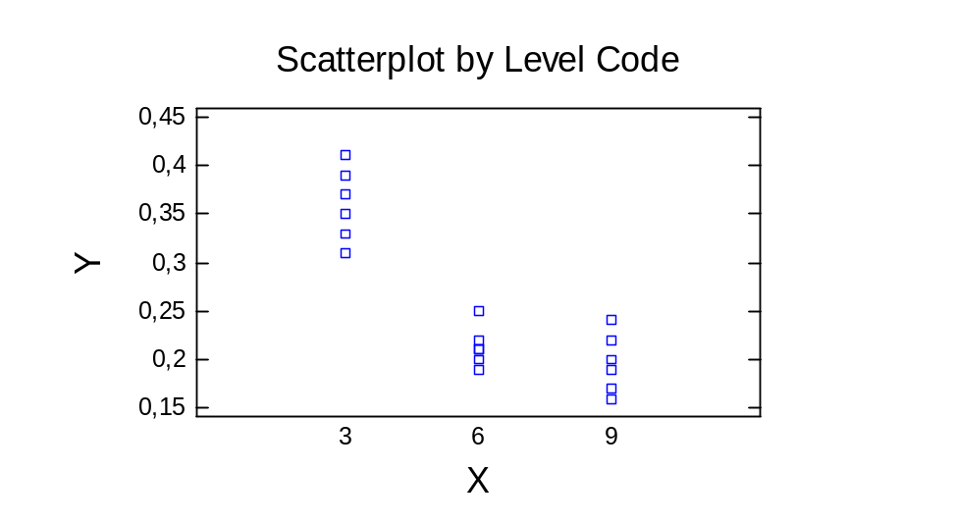
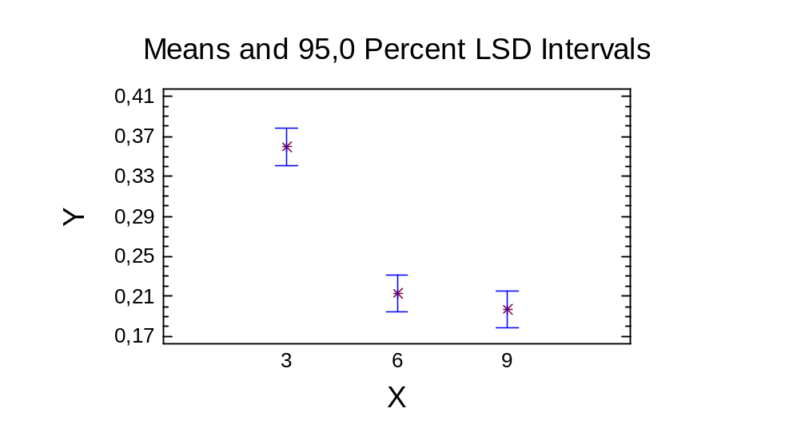
What dose would you recommend to minimize Y?
Based on the LSD intervals, dose = 6 OR dose = 9 (the difference between both doses is not statistically significant)
BUT if the factor is quantitative, the interest is to study if there is a “relationship” between X and Y (and not the comparison between tested levels)
ANOVA => H₀: m_{dose3} = m_{dose6} = m_{dose9}
REGRESSION => Y = a + b·X + c·X² H₀: b = 0 H₀: c = 0
16
It makes more sense to analyze data with regression !!

Slide 17

ANOVA
with >1 factors
17

Slide 18
ANOVA WITH 3 FACTORS
One experiment has been carried out to determine the optimum conditions that maximize the quality parameter (Y) of a chemical product. Three experimental factors are considered:
- Catalyst (two types tested: A or B)
- Supplier of the raw material (s1 or s2)
- Temperature of the reaction (two levels tested: 70ºC and 80ºC)
catalyst
supplier
temperature
Y
A
s1
70
15
B
s1
70
20
A
s2
70
16
B
s2
70
14
A
s1
80
17
B
s1
80
23
A
s2
80
10
18
B
s2
80
13

Slide 19

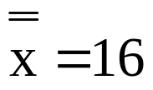


What operative conditions should be adopted to maximize Y?
One engineer thinks that, since the highest value is 23, the optimum conditions would be: Catalyst B, suppler s1, Tª = 80
Is this the “best” operative condition?
NO: the effect of all factors may not be statistically significant !
catalyst X_{obs}
X_{pred}
A
A
A
A
B
B
B
B
15
16
17
10
20
14
23
13
(15 -16)²
(16 -16)²
(17 -16)²
(10 -16)²
(20 -16)²
(14 -16)²
(23 -16)²
(13 -16)²
14.5
14.5
14.5
14.5
17.5
17.5
17.5
17.5
(14.5 - 16)²
(14.5 - 16)²
(14.5 - 16)²
(14.5 - 16)²
(17.5 - 16)²
(17.5 - 16)²
(17.5 - 16)²
(17.5 - 16)²
19
sum: 116 = SS_{TOTAL}
18 = SS_{CATALYST}

Slide 20
X_{obs} suppl
X_{pred}
Temp.
X_{pred}
15
20
17
23
16
14
10
13
s1
s1
s1
s1
s2
s2
s2
s2
18.75
18.75
18.75
18.75
13.25
13.25
13.25
13.25
(18.75 - 16)²
(18.75 - 16)²
(18.75 - 16)²
(18.75 - 16)²
(13.25 - 16)²
(13.25 - 16)²
(13.25 - 16)²
(13.25 - 16)²
70
70
80
80
70
70
80
80
16.25
16.25
15.75
15.75
16.25
16.25
15.75
15.75
(16.25 - 16)²
(16.25 - 16)²
(15.75 - 16)²
(15.75 - 16)²
(16.25 - 16)²
(16.25 - 16)²
(15.75 - 16)²
(15.75 - 16)²
SS_{SUPPL} = 60.5
SS_{TEMP} = 0.5
FACTOR
S.S.
D.F.
M.S.
F_{ratio}
catalyst
18
1
18
1.95
<<7.71
supplier
60.5
1
60.5
6.54
<7.71
temperature
0.5
1
0.5
0.05
<<7.71
RESIDUAL
37
4
9.25
20
TOTAL
116
7
F_{1;4}^{0.05} = 7.71

Slide 21

ANOVA table after discarding non-significant factors:
FACTOR
S.S.
D.F.
M.S.
F_{ratio}
supplier
60.5
1
60.5
6.54
>5.99
RESIDUAL
55.5
6
9.25
TOTAL
116
7
F_{1;6}^{0.05} = 5.99
Factor supplier is statistically significant (α=0.05)
Optimum conditions to maximize Y: use supplier s1 for the raw material; use either Tª 70 or 80; use either catalyst A or B.
Average value of Y using supplier s1:
Next, we should check that:
- Residuals follow a Normal distributions (no outliers)
- The interaction between supplier and Tª or catalyst is not statistically significant
21
WHAT IS AN INTERACTION ?

Slide 22
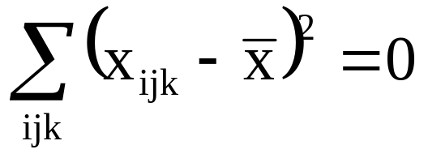
INTUITIVE EXAMPLE:
EFFECT OF THE PAINTING LAYER AND METAL TYPE ON THE CORROSION RATE (C.R.) OF 12 PROTOTYPES
CASE A:
C.R.
THICKNESS OF PAINTING
1
2
3
1
20 20
20 20
20 20
20
METAL TYPE
20 20
20 20
20 20
2
1
2
3
T.P.
i:thickness
TOTAL SUM OF SQUARES:
j: metal type
k: repetition
IF THERE IS NO VARIANCE,
NOTHING HAS INFLUENCE !
22

Slide 23
C.R.
THICKNESS OF PAINTING
CASE B:
1
2
3
30
1
20 20
20 20
20 20
METAL TYPE
20
2
30 30
30 30
30 30
SS_{TOTAL} = SS_{METAL}
1
2
3
T.P.
The factor metal type has an effect on the mean.
C.R.
CASE C:
THICKNESS OF PAINTING
40
1
2
3
35
30
1
20 20
25 25
30 30
METAL TYPE
25
30 30
35 35
40 40
20
2
1
2
3
T.P.
THERE IS VARIABILITY (SS_{TOTAL}≠0) DUE TO THE
EFFECT OF THE METAL TYPE AND THE THICKNESS
23
SS_{TOTAL} = SS_{METAL} + SS_{THICKNESS}

Slide 24
C.R.
CASE D:
50
45
THICKNESS OF PAINTING
40
1
2
3
35
30
1
20 20
25 25
30 30
25
METAL TYPE
20
30 30
40 40
50 50
2
1
2
3
T.P.
THERE IS VARIABILITY DUE TO BOTH FACTORS
AND THEIR INTERACTION
SS_{TOTAL} = SS_{METAL} + SS_{THICKNESS} + SS_{INTERACTION}
24

Slide 25
C.R.
CASE E:
50
45
THICKNESS OF PAINTING
40
35
1
2
3
30
1
25
19 21
27 24
28 32
METAL TYPE
20
30 31
42 39
47 51
2
1
2
3
T.P.
(THE ONLY ONE REALISTIC)
THE EFFECTS OF FACTORS ARE PARTIALLY MASKED (HIDDEN) BY THE RESIDUAL VARIABILITY DUE TO UNCONTROLLED FACTORS
THE CORROSION OF TESTED PROTOTYPES WITH THE SAME METAL AND PAINTING THICKNESS IS NOT EXACTLY THE SAME
SS_{TOTAL} = SS_{METAL} + SS_{THICKNESS} + SS_{INTERACTION} + SS_{RESIDUAL}
25

Slide 26
DEFINITION: There is interaction between 2 factors if the effect of one of them is different according to the level of the other factor.
Result
B at level +
B at level +
Result
  x
C⁺
  x
B⁺
  x
C⁺
  x
B⁺
C⁻
C⁺
B⁺
  x
B⁻
C⁻
C has effect
B at level -
C has no effect
B at level -
B has effect
B has effect
B⁺
  x
No interaction
  x
  x
No interaction
C⁻
C⁻
C⁺
B⁻
B⁻
B⁻
-
+
-
+
Factor C
Factor C
  x
C⁺
Result
B at level +
B⁺
Result
  x
C⁺
Strong interaction (discussing simple effects does not make sense)
  x
B⁻
  x
B at level -
C⁻
C has effect
C⁻
B⁺
B⁺
B has effect
B at level +
  x
  x
B at level -
Slight interaction
C⁺
C⁺
  x
B⁻
  x
B⁺
C⁻
C⁻
B⁻
B⁻
26
-
+
-
+
Factor C
Factor C

Slide 27
EXERCISE: ANOVA of 2 factors with interaction
One pharmaceutical company wants to improve the yield of a fermentation process (variable Y). For that purpose, an experiment is carried out with 2 factors at 2 levels:
- Concentration of nitrogen (two levels tested: 40 and 50)
- Type of raw material (two types tested: A or B)
RESULTS
What concentration and type of raw material should the company choose to maximize the yield?
concentr.
raw material
Y
40
A
46
42
40
A
38
40
B
42
40
B
38
34
50
A
32
30
50
A
28
50
B
51
Highest value ->
Solution: conc = 50
raw mat = B
50
27
50
B
49

Slide 28
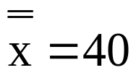


One engineer thinks that, since the highest average value is 50, the optimum conditions would be: conc = 50 and raw material = B
Is this the “best” operative condition?
ONLY IF the effect of both factors or their interaction is statistically significant !
concentr X_{obs}
X_{pred}
40
40
40
40
50
50
50
50
46
38
42
34
32
28
51
49
(46 - 40)²
(38 - 40)²
(42 - 40)²
(34 - 40)²
(32 - 40)²
(28 - 40)²
(51 - 40)²
(49 - 40)²
40
40
40
40
40
40
40
40
(40 - 40)²
(40 - 40)²
(40 - 40)²
(40 - 40)²
(40 - 40)²
(40 - 40)²
(40 - 40)²
(40 - 40)²
28
sum: 490 = SS_{TOTAL}
0 = SS_{CONCENTR}

Slide 29


raw_m X_{obs}
X_{pred}
A
A
A
A
B
B
B
B
46
38
32
28
42
34
51
49
36
36
36
36
44
44
44
44
(36 - 40)²
(36 - 40)²
(36 - 40)²
(36 - 40)²
(44 - 40)²
(44 - 40)²
(44 - 40)²
(44 - 40)²
F_{1, 5}
SS_{RAW_M} = 128
α=0.05
6.61
FACTOR
S.S.
D.F.
M.S.
F_{ratio}
concentration
0
1
0
0
raw material
128
1
128
1.77
<<6.61
RESIDUAL
362
5
72.4
29
TOTAL
490
7

Slide 30
Next step: discard concentration and repeat the ANOVA, but raw material is not statistically significant.
QUESTION: what are the optimum operative conditions in this case?
The analysis is not finished until we check:
- If residuals follow a Normal distributions (no outliers)
- If the interaction between both factors is statistically significant
Graphical study of the interaction:
55
QUESTION: Do you think that the observed pattern was obtained by random?
50
rm=B
yield
45
40
- YES (interaction not significant):
optimum conditions = either of them
rm=A
35
30
- NO (interaction significant):
optimum conditions = 50 ; B
25
20
40
50
concentration
Calculate the sum of squares of the interaction and include it in the ANOVA table
30

Slide 31
X_{obs}
X_{pred}
Conc Raw_m
40
40
40
40
50
50
50
50
A
A
B
B
A
A
B
B
46
38
42
34
32
28
51
49
42
42
38
38
30
30
50
50
(42 - 40)²
(42 - 40)²
(38 - 40)²
(38 - 40)²
(30 - 40)²
(30 - 40)²
(50 - 40)²
(50 - 40)²
Σ = 416 =
= SS_{C} + SS_{RM} + SS_{C·RM}
SS_{CONC·RAWM} = 416 - 128 - 0 = 288
FACTOR
S.S.
D.F.
M.S.
F_{ratio}
concentr.
0
1
0
0
<<7.71
raw material
128
1
128
6.92
<7.71
conc x raw m
288
1·1
288
15.6
>7.71
RESIDUAL
74
4
18.5
31
TOTAL
490
7
F_{1;4}^{0.05} = 7.71

Slide 32
The interaction between concentration and raw material is statistically significant (at α=0.05) although the simple effect of both factors is not.
In order to maximize the yield, the company should use:
concentration of nitrogen = 50; raw material of type B
Average yield expected at those conditions = (51+49)/2 = 50
RULE: if a double interaction is significant, both factors should always be included in the ANOVA table.
RULE: degrees of freedom of CONCxRAW_M = (d.f._{CONC})·(d.f._{RAW_M})
With >2 factors, triple interactions should also be studied, though in most cases they are not significant.
32

Slide 33

DESIGN OF
EXPERIMENTS
33

Slide 34
EXPERIMENT: SET OF TRIALS CARRIED OUT TO OBTAIN INFORMATION IN ORDER TO IMPROVE A PRODUCT OR PROCESS.
Common approach used optimize industrial processes:
A B C
Response
A B C
Response
A B C
Response
- - -
........
+ - -
........
+ + -
........
- - -
+ - -
+ + -
- - -
+ - -
+ + -
- - -
+ - -
+ + -
+ - -
+ + -
+ + +
+ - -
+ + -
+ + +
+ - -
+ + -
+ + +
+ - -
+ + -
+ + +
A⁺ better than A⁻
B⁺ better than B⁻
C⁺ better than C⁻
Total number of experimental trials = 24
Optimum Operative Condition (OOC) : A⁺ B⁺ C⁺ ?
Have we tested all possible combinations?
THIS APPROACH (modify one factor each time) IS NOT EFFICIENT:
- Very expensive (requires many trials).
- It does not guarantee obtaining the Optimum Operative Cond.
- It is not possible to study the effect of interactions.
34

Slide 35
ALTERNATIVE approach, much more effective:
¡ USE A FACTORIAL EXPERIMENTAL DESIGN TO STUDY THE SIMULTANEOUS EFFECT OF ALL FACTORS!
A B C
- - -
- ALL POSSIBLE OPERATIVE CONDITIONS HAVE BEEN TESTED
+ - -
- + -
+ + -
- ONLY 8 TRIALS ARE NECESSARY (versus 24 trials in the traditional approach)
- - +
+ - +
- ALL EFFECTS ARE ORTHOGONAL AND IT IS POSSIBLE TO STUDY THE EFFECT OF INTERACTIONS
- + +
+ + +
CONTROLED FACTORS: Parameters of the process under study that are tested at two or more levels or variants, in order to investigate the effect over the response variable.
35

Slide 36
DESIGN OF EXPERIMENTS (DOE)
Quantitative factors => variants ; Qualitative factors => levels
Experimental design with 3 factors: F1 with 2 variants (A, B), F2 with 2 levels (2, 3), F3 with 2 variants (X, Y)
Response variable (measured experimentally):
F1
A
B
A
B
A
B
A
B
F2
2
2
3
3
2
2
3
3
F3
X
X
X
X
Y
Y
Y
Y
RV
3.5
4.9
3.2
6.2
5.3
4.7
2.9
4.8
- Treatments: different combinations of variants/levels: 2 · 2 · 2 = 8
- Repetitions / replicates: number of times that each treatment is tested
- Trials: number of experiments carried out
Trials = treatments x repetitions
Factorial design not replicated (8 treatments, 8 trials)
36

Slide 37
BALANCED FACTORIAL DESIGN: all treatments are tested the same number N_{R} of times.
IF N_{R}=1: non-replicated factorial design.
PROPERTY: effect of ALL factors and interactions are orthogonal among them
STEPS TO DESIGN AN EXPERIMENT
0.- TO DEFINE THE PROBLEM AND ESTABLISH THE OBJECTIVE
1.- TO IDENTIFY THE RESPONSE VARIABLE
2.- TO SELECT THE FACTORS AND DECIDE THE LEVELS / VARIANTS
4.- TO DEFINE WHAT WILL CONSTITUTE EACH INDIVIDUAL TRIAL
5.- TO DECIDE THE NUMBER OF TRIALS TO CARRY OUT
5’.- TO DECIDE THE TREATMENT TO USE IN EACH TRIAL
6.- TO ORGANIZE ALL THE WORK; TO CARRY OUT THE EXPERIMENT
7.- TO ANALYZE STATISTICALLY THE RESULTS
IMPORTANT: TRIALS SHOULD ALWAYS BE CARRIED OUT IN A RANDOM ORDER
(to avoid confusion of effects with uncontrolled factors)
37

Slide 38
ANALYSIS OF RESULTS IN A DOE:
1) Identify with ANOVA which effects are statistic. significant
2) Interpretation of the nature of significant effects:
- if factors are QUALITATIVE : use of LSD INTERVALS
- if factors are QUANTITATIVE and tested at >2 levels: the best method is multiple linear regression
3) Analysis of residuals:
- DETECTION OF OUTLIERS
- EFFECTS OF FACTORS OVER THE VARIANCE OF THE RESPONSE VARIABLE
FACTORS AT 3 LEVELS:
Experiments require a higher number of trials BUT provide more information about linear / quadratic effects that allows a better estimation of the optimum operative conditions.
38

Slide 39
3) INDEPENDENCE:
The data analysis with ANOVA implies 3 assumptions:
1) The populations corresponding to all tested treatments have the SAME variance.
(ANOVA is quite robust though variances are not all equal)
2) NORMALITY:
The response variable has a Normal distribution in all treatments
- If the distribution is highly skewed => use transformations
(e.g. work with log(X) or X^{0.5} instead of X)
The most important !!
Observations from each treatment correspond to individuals extracted randomly from the population considered.
Data resulting from the different treatments are independent among them.
To accomplish this hypothesis it is necessary to randomize the order of all trials in the experiment.
39

Slide 40
ORTHOGONALITY
F1
A
B
A
B
A
B
A
B
F2
2
3
2
3
2
3
2
3
F3
X
X
X
X
Y
Y
Y
Y
RV
3.5
4.9
3.2
6.2
5.3
4.7
2.9
4.8
3 factors, 8 treatments, 8 trials...
but is there anything “wrong”?
The effect of factor F1 is totally confounded with the effect of factor F2 --> BAD DESIGN!
If this effect is statistically significant, it is NOT possible to know if it was caused by F1, F2 or both.
F1
A
B
A
B
A
B
A
B
F2
2
3
2
2
3
3
2
3
F3
X
X
X
X
Y
Y
Y
Y
RV
3.5
4.9
3.2
6.2
5.3
4.7
2.9
4.8
Is there anything “wrong”?
- Variant A of F1 was tested 3 times at F2=2 and 1 time at F2=3
- Variant B of F1 was tested 1 time at F2=2 and 3 times at F2=3
F1=A F2=2 F1=B F2=3
The effect of factor F1 is partly confounded with the effect of factor F2
40

Slide 41
QUESTION: is this a good or bad DOE ?
F1
2
2
2
2
2
2
3
3
3
3
F2
A
B
A
B
A
B
A
B
A
B
RV
3.5
4.9
3.2
6.2
5.3
4.7
2.9
4.8
5.4
2.7
Is there anything “wrong”?
NO (the design is correct), but F1 was tested 6 times at level 2 and 4 times at level 3.
UNBALANCED DESIGN
If each treatment is tested the same number of times => balanced factorial design
A balanced DOE is better, unless σ²_{F1=2} > σ²_{F1=3}
3 times at F2=A (50%=A)
F1=2
3 times at F2=B (50%=B)
Same proportion:
“F1 and F2 are orthogonal”
(F1 and F2 are not confounded)
2 times at F2=A (50%=A)
F1=3
2 times at F2=B (50%=B)
41

Slide 42
Given 2 factors (F_{I} with I variants and F_{J} with J variants): the simple effect of both factors will be orthogonal if in each variant of I, the proportions of J variants are the same.
Consequently: it is possible to separate the effect of each factor on the variable under study
QUESTION: is this a good or bad DOE ?
DOE with 3 factors: A (2 levels), B (3 levels), C (2 levels):
A B C
1 1 1
1 2 2
1 3 2
2 1 1
2 2 2
2 3 2
Are A and B orthogonal?
Are A and C orthogonal?
Are B and C orthogonal?
42

Slide 43
QUESTION:
Is the simple effect of F3 orthogonal to the interaction F1 x F2?
F1
A
B
A
B
A
B
A
B
F2
2
2
3
3
2
2
3
3
F3
X
X
X
X
Y
Y
Y
Y
RV
3.5
4.9
3.2
6.2
5.3
4.7
2.9
4.8
1 time at F1=A; F2=2 (25%=A·2)
1 time at F1=B; F2=2 (25%=B·2)
F3=X
1 time at F2=A; F2=3 (25%=A·3)
1 time at F2=B; F2=3 (25%=B·3)
1 time at F1=A; F2=2 (25%=A·2)
1 time at F1=B; F2=2 (25%=B·2)
F3=Y
1 time at F2=A; F2=3 (25%=A·3)
1 time at F2=B; F2=3 (25%=B·3)
Same proportion: “F3 is orthogonal to the interaction F1 x F2”
(F3 and the interaction F1 x F2 are not confounded)
Exercise: in a factorial plan 2⁴, check that AxB is orthogonal to CxD. Check also that AxBxC is orthogonal to D.
43

Slide 44
QUESTION:
DOE 1
F1 F2 F3
1 1 1
2 1 1
1 2 1
2 2 1
1 1 2
2 1 2
1 2 2
2 2 2
In DOE1, check that:
F1 is orthogonal to F2
F1 is orthogonal to F3
F2 is orthogonal to F3
F1 is orthogonal to F2xF3
F2 is orthogonal to F1xF3
F3 is orthogonal to F1xF2
DOE 2
F1 F2 F3 F4
1 1 1 1
1 2 2 2
1 3 3 3
2 1 2 3
2 2 3 1
2 3 2 2
3 1 3 2
3 2 1 3
3 3 2 1
In DOE2, check that F1 vs F2, F1 vs F3,
F1 vs F4, F2 vs F3, F2 vs F4, F3 vs F4 are orthogonal.
Are the simple effects orthogonal to the double interactions?
How many trials would have the “complete” DOE?
44

Slide 45
What happens if 2 effects are confounded? (for example the simple effect of A and the interaction B·C)
- It is not possible to separate the effect of A vs BC
- We may assume that the effect of A is more important than BC, but this may not be true in practice.
Question: is this DOE good or bad?
Check the orthogonality between F1 vs F2; F1 vs F3 ; F2 vs F3
F₁
A
B
B
A
F₂
2
3
2
3
F₃
X
X
Y
Y
RV
3.5
4.9
3.2
6.2
The effect of F3 is confounded with effect of F1xF2, but this design is the best possible with just 4 trials
45

Slide 46
all factors are tested at 2 levels/variants
- Experiments are easier as they have a lower number of trials.
- The effects of factors and interactions are easy to interpret.
- Possible quadratic effects cannot be detected.
Design 2^{K}: it is possible to calculate from the data 2^{K}-1 effects
Relevants
in practice
K SIMPLE EFFECTS (each one with 1 degr. freedom)
K
DOUBLE INTERACTIONS (each one with 1x1 = 1 d.f.)
2
K
TRIPLE INTERACTIONS (each one with 1x1x1 = 1 d.f.)
3
.........................
K
=1
INTERACTIONS OF ORDER K (with 1 d.f.)
K
EXAMPLE:
In a 2⁴ plan it is possible to calculate 4 simple effects of factors, 6 double interactions, 4 triple int. and 1 quadruple int. = 15 effects
46
It is recommended that d.f. residual ≥ 10 (at least d.f. res. ≥ 4)

Slide 47
FRACTIONAL FACTORIAL DESIGN 2^{k-1}
K factors are tested at 2 levels with only HALF of the trials (i.e., 2^{K-1} trials) that would be necessary for the complete design.
In order to build a 2^{K-1} design:
1) Start with a complete 2^{K} design
2) Multiply the sign of all factors (interaction of highest order)
3) Select those trials with the “ + ” sign (or -)
In a 2^{k}
design:
- It is not possible to study the effect of the highest-order interaction, but this effect is likely to be the least important.
- The simple effect of a factor is confounded with the (k-1) order interaction of the remaining factors.
- The double interaction of 2 factors is confounded with the (k-2) order interaction of the remaining factors.
- Two effects (simple or interactions) will be completely confounded if their signs are coincident in all trials (for interactions, multiply sings of the factors).
47

Slide 48
DOE with 4 factors at 2 levels. Which treatments should we select from the complete design to carry out only 8 trials?
A
B
C
D
ABCD
This is the best possible DOE with 8 trials because:
a) Each factor is tested 4 times at level (-) and 4 times at level (+)
1
-
-
-
-
+
2
3
4
+
+
-
-
+
5
b) The effect of each factor is orthogonal to the remaining factors and to the double interactions!
6
+
-
+
-
+
7
-
+
+
-
+
8
EXERCISE: check that the simple effect of A is orthogonal to the interaction B·C
9
10
+
-
-
+
+
11
-
+
-
+
+
Check that the simple effect of A is not orthogonal to the interaction B·C·D
12
13
-
-
+
+
+
14
Trials selected so that ABCD = (+)
15
16
+
+
+
+
+
48

Slide 49
Example: in a DOE 2⁶ (6 factors, 64 trials), it is possible
to estimate 63 effects: 6 simple effects, 15 double interactions,
20 triple int., 15 quadruple int., 6 5th-order int., 1 6th-order int.
BUT most of them (interactions of order >2) will be irrelevant !
It is of interest to reduce the number of trials “sacrificing” certain precision and the possibility to study high-order interactions.
A GOOD FRACTIONAL FACTORIAL DESIGN:
A) Should NEVER confound simple effects between them
B) Should TRY (if possible) to avoid confusion between simple effects and double interactions.
(because they exist sometimes, and this confusion would result in a wrong interpretation of results)
C) If possible, should NOT confound double interactions between them (in order to study them).
49

Slide 50
ORTHOGONAL ARRAYS L_{8 ,} L_{16 ,} L_{18 ,} L₂₆
Orthogonal arrays are tables proposed to simplify the design of fractional factorial plans
Developed in Japan by prof. G. Taguchi
1 2 3 4 5 6 7
1 1 1 1 1 1 1 1
2 1 1 1 2 2 2 2
3 1 2 2 1 1 2 2
4 1 2 2 2 2 1 1
5 2 1 2 1 2 1 2
6 2 1 2 2 1 2 1
7 2 2 1 1 2 2 1
8 2 2 1 2 1 1 2
Orthogonal array L8:
allows the study of up to 7 factors with 8 trials:
L₈ ( 2 ⁷ ⁻ ⁴ )
50

Slide 51
1 2 3 4 5 6 7 8 9 10 11 12 13 14 15
1 1 1 1 1 1 1 1 1 1 1 1 1 1 1 1
2 1 1 1 1 1 1 1 2 2 2 2 2 2 2 2
3 1 1 1 2 2 2 2 1 1 1 1 2 2 2 2
4 1 1 1 2 2 2 2 2 2 2 2 1 1 1 1
5 1 2 2 1 1 2 2 1 1 2 2 1 1 2 2
6 1 2 2 1 1 2 2 2 2 1 1 2 2 1 1
7 1 2 2 2 2 1 1 1 1 2 2 2 2 1 1
8 1 2 2 2 2 1 1 2 2 1 1 1 1 2 2
9 2 1 2 1 2 1 2 1 2 1 2 1 2 1 2
10 2 1 2 1 2 1 2 2 1 2 1 2 1 2 1
11 2 1 2 2 1 2 1 1 2 1 2 2 1 2 1
12 2 1 2 2 1 2 1 2 1 2 1 1 2 1 2
13 2 2 1 1 2 2 1 1 2 2 1 1 2 2 1
14 2 2 1 1 2 2 1 2 1 1 2 2 1 1 2
15 2 2 1 2 1 1 2 1 2 2 1 2 1 1 2
16 2 2 1 2 1 1 2 2 1 1 2 1 2 2 1
L₁₆
(2¹⁵⁻¹¹)
51

Slide 52
ORTOGONAL ARRAY L₁₈
L₁₈ (2¹*3⁷)
1 2 3 4 5 6 7 8
1 1 1 1 1 1 1 1 1
2 1 1 2 2 2 2 2 2
3 1 1 3 3 3 3 3 3
4 1 2 1 1 2 2 3 3
5 1 2 2 2 3 3 1 1
6 1 2 3 3 1 1 2 2
7 1 3 1 2 1 3 2 3
8 1 3 2 3 2 1 3 1
9 1 3 3 1 3 2 1 2
10 2 1 1 3 3 2 2 1
11 2 1 2 1 1 3 3 2
12 2 1 3 2 2 1 1 3
13 2 2 1 2 3 1 3 2
14 2 2 2 3 1 2 1 3
15 2 2 3 1 2 3 2 1
16 2 3 1 3 2 3 1 2
17 2 3 2 1 3 1 2 3
18 2 3 3 2 1 2 3 1
18 trials instead of 4,374
Simple effects account for
1+7x2 = 15 d.f., remaining 2 d.f. that are associated to the interaction F1xF2
EXERCISE: check that the interaction F1xF2 is orthogonal to all simple effects.
EXERCISE: check that the interaction F1xF3 is NOT orthogonal to the simple effect of F4
52

Slide 53
1 2 3 4 5 6 7 8 9 10 11 12 13
1 1 1 1 1 1 1 1 1 1 1 1 1 1
2 1 1 1 1 2 2 2 2 2 2 2 2 2
3 1 1 1 1 3 3 3 3 3 3 3 3 3
4 1 2 2 2 1 1 1 2 2 2 3 3 3
5 1 2 2 2 2 2 2 3 3 3 1 1 1
6 1 2 2 2 3 3 3 1 1 1 2 2 2
7 1 3 3 3 1 1 1 3 3 3 2 2 2
8 1 3 3 3 2 2 2 1 1 1 3 3 3
9 1 3 3 3 3 3 3 2 2 2 1 1 1
10 2 1 2 3 1 2 3 1 2 3 1 2 3
11 2 1 2 3 2 3 1 2 3 1 2 3 1
12 2 1 2 3 3 1 2 3 1 2 3 1 2
13 2 2 3 1 1 2 3 2 3 1 3 1 2
14 2 2 3 1 2 3 1 3 1 2 1 2 3
15 2 2 3 1 3 1 2 1 2 3 2 3 1
16 2 3 1 2 1 2 3 3 1 2 2 3 1
17 2 3 1 2 2 3 1 1 2 3 3 1 2
18 2 3 1 2 3 1 2 2 3 1 1 2 3
19 3 1 3 2 1 3 2 1 3 2 1 3 2
20 3 1 3 2 2 1 3 2 1 3 2 1 3
21 3 1 3 2 3 2 1 3 2 1 3 2 1
22 3 2 1 3 1 3 2 2 1 3 3 2 1
23 3 2 1 3 2 1 3 3 2 1 1 3 2
24 3 2 1 3 3 2 1 1 3 2 2 1 3
25 3 3 2 1 1 3 2 3 2 1 2 1 3
26 3 3 2 1 2 1 3 1 3 2 3 2 1
27 3 3 2 1 3 2 1 2 1 3 1 3 2
ORTOGONAL ARRAY L₂₇
27 trials
instead of 1,584,323
Design completely saturated: simple effects account for 13·2=26 degrees of freedom, which are the total d.f. available (27-1)
53

Slide 54

EXERCISES
Data in PoliformaT:
recursos \ Transparencias \ English group \ UD 5 DOE-data.xls
54

Slide 55

















EXERCISE-1
In order to study the yield of orange trees, 3 cultivars were tested (A, B, C) as well as different heights of pruning. Results:
A B C
68 52 66
60 55 72
62 61 68
91 62 83
75 67 82
86 60 78
90 64 72
98 75 66
94 74 74
105 68 61
95 85 58
99 83 58
Height 0.75
Height 1
Height 1.25
Height 1.50
55

Slide 56
Summary table of ANOVA:
Multifactor ANOVA - yield
Analysis of Variance for yield - Type III Sums of Squares
--------------------------------------------------------------------------------
Source Sum of Squares Df Mean Square F-Ratio P-Value
--------------------------------------------------------------------------------
MAIN EFFECTS
A:cultivar 2287,17 2 1143,58 42,93 0,0000
B:height 1613,64 3 537,88 20,19 0,0000
INTERACTIONS
AB 2284,61 6 380,769 14,29 0,0000
RESIDUAL 639,333 24 26,6389
--------------------------------------------------------------------------------
TOTAL (CORRECTED) 6824,75 35
--------------------------------------------------------------------------------
100
yield
90
cultivar A
80
cultivar B
70
cultivar C
60
50
56
0,5
0,75
1
1,25
1,5
1,75
height

Slide 57
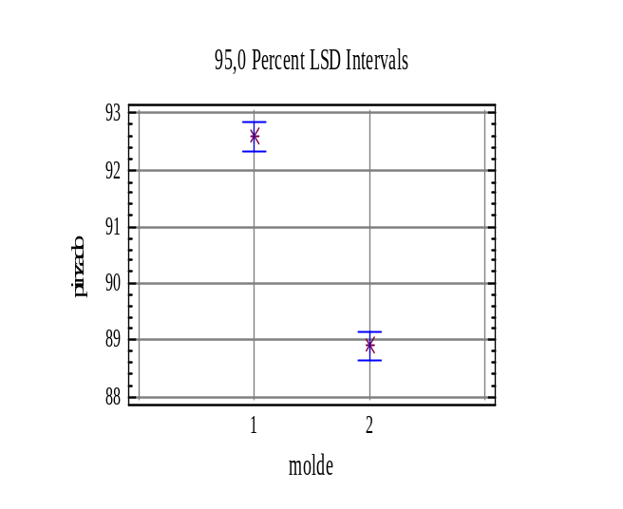
EXERCISE-2:
REPLICATED DESIGN
Catalyst
A B C
93 92 95
93 94 94
90 90 94
91 91 94
1 92 90 94
91 91 97
90 92 95
91 92 96
93 92 94
90 91 96
88 90 91
88 88 90
87 88 92
87 88 90
2 88 89 91
87 90 89
87 89 90
87 88 91
87 88 91
88 89 91
DESIGN: balanced factorial plan 3x2 with 10 replicates
Experiment to investigate the effect of catalyst and cast type in a quality parameter of PET bottles.
Target: minimize the response variable.
Cast:
57

Slide 58
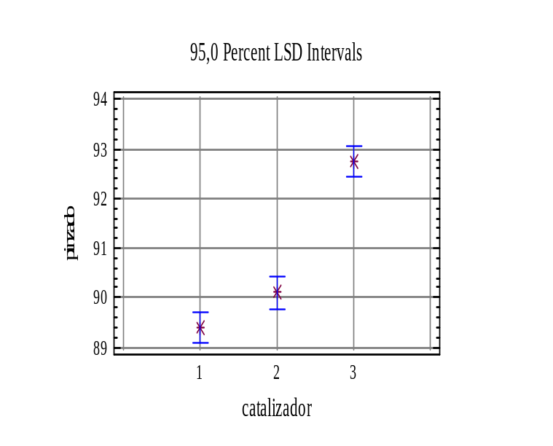
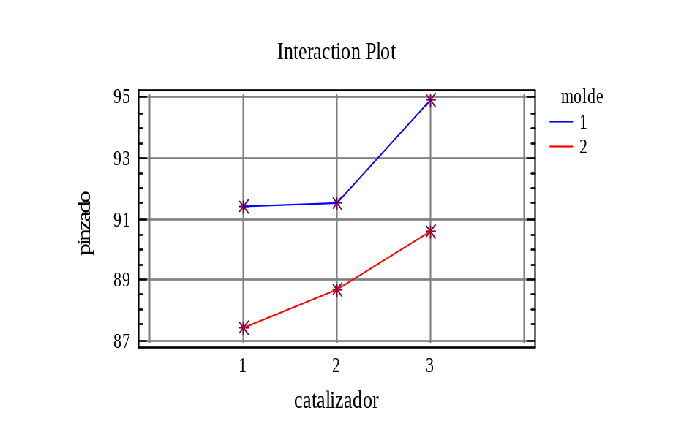
Analysis of Variance for pinzado - Type III Sums of Squares
--------------------------------------------------------------------------------
Source Sum of Squares Df Mean Square F-Ratio P-Value
--------------------------------------------------------------------------------
MAIN EFFECTS
A:catalyst 124,9 2 62,45 63,99 0,0000
B:cast (molde) 205,35 1 205,35 210,42 0,0000
INTERACTIONS
AB 6,3 2 3,15 3,23 0,0474
RESIDUAL 52,7 54 0,975926
--------------------------------------------------------------------------------
TOTAL (CORRECTED) 389,25 59
--------------------------------------------------------------------------------
LSD INTERVALS
58
Optimum Operative Condition (to minimize): Catalyst (1), cast (2)

Slide 59
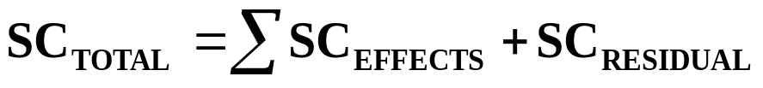
EXERCISE-3: DESIGN 2³ NON-REPLICATED
RESPONSE VARIABLE: a measurement of the degree of corrosion of vehicle metal sheet (this variable should be kept as low as possible).
Electrocoat
Metal sheet
FACTORS:
Primer
Enamel
EC
PR
EN
LEVELS for each factor: 2 different
thickness (2 microns vs 5 microns)
EC
PR
EN
corrosion
-
+
-
+
-
+
-
+
-
-
+
+
-
-
+
+
-
-
-
-
+
+
+
+
14
10
8
6
12
4
6
2
NUMBER OF TRIALS = 8 :
2³ non-replicated
59

Slide 60
ANALYSIS OF VARIANCE
What effects are statistically significant?
EFFECT
S.S.
D.f.
M.S.
F-ratio
F-table
P-value
TOTAL
115.5
7
-
-
EC
40.5
1
40.5
16.2
7.71
0.0158
PR
40.5
1
40.5
16.2
7.71
0.0158
EN
24.5
1
24.5
9.8
7.71
0.0352
ECxPR
ECxPR
4.5
4.5
1
1
4.5
4.5
ECxES
4.5
1
4.5
ECxES
4.5
1
4.5
PRxES
PRxES
0.5
0.5
1
1
0.5
0.5
ECxPRxES
0.5
1
0.5
RESIDUAL
0.5
1
0.5
RESIDUAL
0
0
0
RESIDUAL
10
4
2.5
IT IS RECOMMENDED THAT d.f.res ≥ 4
Grouping in the SS_{residual} the lowest effects
How can we get d.f. for the SSresidual?
60

Slide 61
OPTIMUM OPERATIVE CONDITION (OOC)
Combination of significant factors that optimize (maximize or minimize) the response variable.
O.O.C. to minimize corrosion: EC⁺ PR⁺ EN⁺ (i.e. thicker layers)
corrosion
corrosion
corrosion
-
+
-
+
-
+
EC
PR
EN
ANALYSIS OF RESIDUALS
Residual for the i-th observation:
e_{i} = (value observed)_{i} – (mean of the treatment)_{i}
IMPORTANT TO:
- Detect outliers
- Check the hypothesis of normality
61
- Study the effects over the variance of corrosion.

Slide 62




EXERCISE-4: REPLICATED DESIGN 2²
In a chemical reaction, the target is to improve the quality of a mixture used to incorporate certain additive to a polymer.
Response variable: % additive Target: maximize
2 FACTORS:
- Stirring speed in the mixing process
- Stirring time
TIME
3 ’
6 ’
17.2
17.0
17.1
16.4
16.8
15.6
600 rpm
18.7
19.0
18.6
19.4
17.7
17.4
SPEED
1000 rpm
62

Slide 63
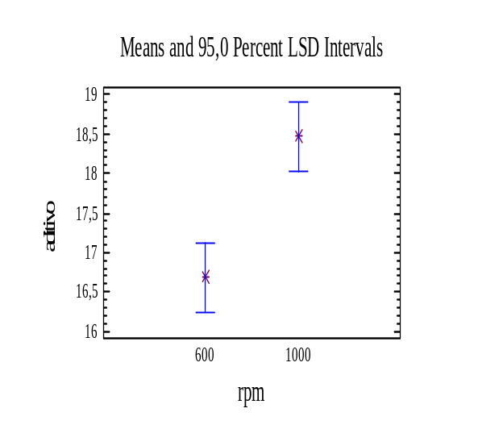
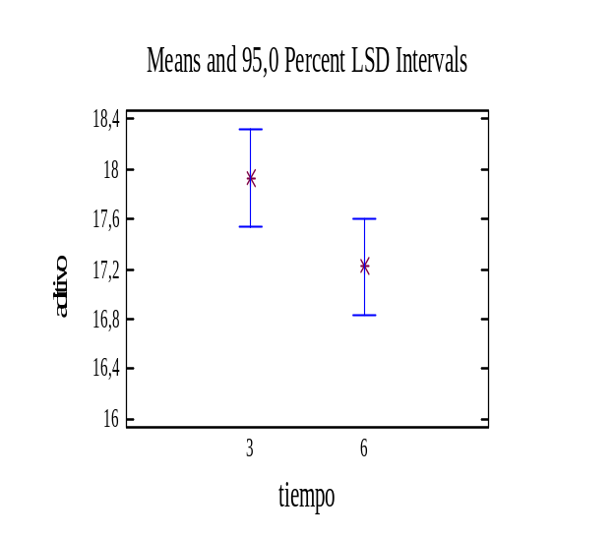
Analysis of Variance for aditivo
---------------------------------------------------------------------
Source Sum of Squares Df Mean Square F-Ratio P-Value
---------------------------------------------------------------------
A:time 1,54083 1 1,54083 3,88 0,0845
B:speed 9,54083 1 9,54083 24,00 0,0012
AB:time*speed 0,04083 1 0,04083 0,10 0,7568
Total error 3,18 8 0,3975
---------------------------------------------------------------------
Total (corr.) 14,3025 11
Effect “nearly” significant
Clearly
significant
No evidence of interaction between both factors
EFFECT OF:
SPEED
TIME
As the effect of time is nearly significant, it seems convenient to take it into account.
63
What would be the OOC ?

Slide 64
EXERCISE-5:
Factorial design 2⁴⁻¹
The effect of 4 factors in the stability of a chemical product is tested (target: maximize the stability)
Variable
-
+
1
Concentration of acid (%)
20
30
2
Concentration of catalyst (%)
1
2
3
Temperature ( º C )
100
150
4
Concentration of monomers
25
50
trial
V1
V2
V3
V4
STABILITY
1
-
-
-
-
20
2
+
-
-
+
14
3
-
+
-
+
17
4
+
+
-
-
10
5
-
-
+
+
19
6
+
-
+
-
13
7
-
+
+
-
14
64
8
+
+
+
+
10

Slide 65
Analysis of Variance for STABILITY - Type III Sums of Squares
--------------------------------------------------------------------------------
Source Sum of Squares Df Mean Square F-Ratio P-Value
--------------------------------------------------------------------------------
A:ACID 66,125 1 66,125 144,27 0,0012
B:TEMPERATURE 3,125 1 3,125 6,82 0,0796
C:MONOMER 1,125 1 1,125 2,45 0,2152
D:CATALYST 28,125 1 28,125 61,36 0,0043
RESIDUAL 1,375 3 0,458333
--------------------------------------------------------------------------------
TOTAL (CORRECTED) 99,875 7
--------------------------------------------------------------------------------
Analysis of Variance for STABILITY - Type III Sums of Squares
--------------------------------------------------------------------------------
Source Sum of Squares Df Mean Square F-Ratio P-Value
--------------------------------------------------------------------------------
MAIN EFFECTS
A:ACID 66,125 1 66,125 58,78 0,0006
B:CATALYST 28,125 1 28,125 25,00 0,0041
RESIDUAL 5,625 5 1,125
--------------------------------------------------------------------------------
TOTAL (CORRECTED) 99,875 7
--------------------------------------------------------------------------------
Exercise: determine the optimum operative conditions
65

Slide 66
Trat.
resp.
A
B
C
D
E
EXERCISE-6
1
15.6
-
-
-
-
-
2
13.5
+
-
-
-
-
In order to improve the yield of a chemical process (target: maximize the response variable), 5 factors are studied
3
16.3
-
+
-
-
-
4
17.1
+
+
-
-
-
5
26.8
-
-
+
-
-
6
25
+
-
+
-
-
7
30
-
+
+
-
-
8
28.9
+
+
+
-
-
Trat.
resp.
A
B
C
D
E
9
15.4
-
-
-
+
-
21
47.4
-
-
+
-
+
10
12.7
+
-
-
+
-
22
44.2
+
-
+
-
+
11
15.3
-
+
-
+
-
23
52.6
-
+
+
-
+
12
15.9
+
+
-
+
-
24
46.2
+
+
+
-
+
13
20.3
-
-
+
+
-
25
27.8
-
-
-
+
+
14
21.3
+
-
+
+
-
26
29.5
+
-
-
+
+
15
27
-
+
+
+
-
27
30.1
-
+
-
+
+
16
24.1
+
+
+
+
-
28
29.6
+
+
-
+
+
17
28.9
-
-
-
-
+
29
35.9
-
-
+
+
+
18
29
+
-
-
-
+
30
36.4
+
-
+
+
+
19
33.7
-
+
-
-
+
31
41
-
+
+
+
+
66
20
33.6
+
+
-
-
+
32
38.6
+
+
+
+
+

Slide 67
1) ANOVA results with data from the 32 trials:
-----------------------------------------------------------------------------------
Source of variation Sum of Squares Df Mean Square F-Ratio Sig. Level
-----------------------------------------------------------------------------------
TOTAL 3514.4847 31
B 79.0653 1 79.0653 21.656 .0001
C 1031.7153 1 1031.7153 282.35 .0000
D 144.0753 1 144.0753 39.462 .0000
E 2101.1403 1 2101.1403 575.499 .0000
C*D 63.562812 1 63.562812 17.410 .0003
RESIDUAL 94.925625 26 3.6509856
--------------------------------------------------------------------------------
2) ANOVA results if ONLY the 16 trials in red had been conducted:
------------------------------------------------------------------------------
Source Sum of Squares Df Mean Square F-Ratio P-Value
------------------------------------------------------------------------------
B 47,2656 1
C 530,151 1
D 60,4506 1
E 1028,81 1
INTERACTIONS
BC 50,0556 1
RESIDUAL
------------------------------------------------------------------------------
TOTAL (CORRECTED) 1774,76
(complete the table and obtain conclusions)
- Check that relevant effects are nearly the same with only 16 trials
67
- Obtain the optimum conditions (solution: B ⁺ C ⁺ D ⁻ E⁺)

Slide 68
EXERCISE-7: FRACTIONAL DOE 2⁶ ⁻³
DOE to study the best conditions for improving the resistance against corrosion of metal sheets
6 factors studied (all at 2 levels)
A
B
C
D
E
F
RESP.
1
-
-
-
+
+
+
8
2
+
-
-
-
-
+
6
3
-
+
-
-
+
-
7
4
+
+
-
+
-
-
7
5
-
-
+
+
-
-
10
6
+
-
+
-
+
-
8
7
-
+
+
-
-
+
8
8
+
+
+
+
+
+
9
68

Slide 69
FACTOR
SS
D.F.
MS
F_{COMPUTED}
A
1.125
1
1.125
9
B
0.125
1
0.125
1
C
6.125
1
6.125
49
D
3.125
1
3.125
25
E
0.125
1
0.125
1
F
0.125
1
0.125
1
RESIDUAL
0.125
1
0.125
It is convenient to group in the SS_{RESIDUAL} those factors clearly not significant in order to have at least 4 residual degrees of freedom
FACTOR
SS
D.F.
MS
F_{COMPUTED}
A
1.125
1
1.125
9
C
6.125
1
6.125
49
D
3.125
1
3.125
25
RESIDUAL
0.5
4
0.125
F_{1 , 4} ( α=0.05 ) = 7.71
Which effects are statistically significant?
69
What would be the operative conditions to maximize the resistance?

Slide 70
EXERCISE-8: FRACTIONAL DOE 2⁶ ⁻²
A DOE is conducted to study the effect of 6 parameters of a chemical process over the resistance obtained in one adhesive (target: MAX.)
X₁ X₂ X₃ X₄ X₅ X₆ y
-1 -1 -1 -1 -1 -1 162
1 -1 -1 -1 1 -1 146
-1 1 -1 -1 1 1 182
1 1 -1 -1 -1 1 133
-1 -1 1 -1 1 1 228
1 -1 1 -1 -1 1 143
-1 1 1 -1 -1 -1 223
1 1 1 -1 1 -1 172
-1 -1 -1 1 -1 1 168
1 -1 -1 1 1 1 128
-1 1 -1 1 1 -1 175
1 1 -1 1 -1 -1 186
-1 -1 1 1 1 -1 197
1 -1 1 1 -1 -1 175
-1 1 1 1 -1 1 196
1 1 1 1 1 1 173
VARIABLE
(units)
LEVEL
-1
1
SACAROSE (GR)
43
71
PARAFORMOL (GRS)
30
42
NaOH (GR)
6
10
WATER (GR)
16
20
MAX. TEMPER. (ºC)
80
90
TIME
25
35
Simple effects are NOT confounded with double interactions
70

Slide 71
It is possible to calculate in total 15 effects (N-1):
· 6 SIMPLE EFFECTS
(confounded with interactions of order > 2 )
· 7 DOUBLE INTERACTIONS
(confounded with interactions of order > 2 )
· 2 INTERACTIONS OF ORDER >2
Analysis of Variance for Y - Type III Sums of Squares
--------------------------------------------------------------------------------
Source Sum of Squares Df Mean Square F-Ratio P-Value
--------------------------------------------------------------------------------
A:F1 4726,56 1 4726,56 14,23 0,0023
B:F3 3220,56 1 3220,56 9,69 0,0082
RESIDUAL 4319,31 13 332,255
--------------------------------------------------------------------------------
TOTAL (CORRECTED) 12266,4 15
--------------------------------------------------------------------------------
We should also check that none of double interactions are significant
Which would be the optimum operative conditions to maximize the resistance?
71
(solution: F1 at level - and F3 at level +)

Slide 72
EXERCISE-9
Prueba A B C D E F G H
1 1 1 1 1 1 1 1 1
2 1 1 2 2 2 2 2 2
3 1 1 3 3 3 3 3 3
4 1 2 1 1 2 2 3 3
5 1 2 2 2 3 3 1 1
6 1 2 3 3 1 1 2 2
7 1 3 1 2 1 3 2 3
8 1 3 2 3 2 1 3 1
9 1 3 3 1 3 2 1 2
10 2 1 1 3 3 2 2 1
11 2 1 2 1 1 3 3 2
12 2 1 3 2 2 1 1 3
13 2 2 1 2 3 1 3 2
14 2 2 2 3 1 2 1 3
15 2 2 3 1 2 3 2 1
16 2 3 1 3 2 3 1 2
17 2 3 2 1 3 1 2 3
18 2 3 3 2 1 2 3 1
TRIAL A B C D E F G H
1 1 1 1 1 1 1 1 1
2 1 1 2 2 2 2 2 2
3 1 1 2 3 2 3 3 3
4 1 2 1 1 2 2 3 3
5 1 2 2 2 2 3 1 1
6 1 2 2 3 1 1 2 2
7 1 3 1 2 1 3 2 3
8 1 3 2 3 2 1 3 1
9 1 3 2 1 2 2 1 2
10 2 1 1 3 2 2 2 1
11 2 1 2 1 1 3 3 2
12 2 1 2 2 2 1 1 3
13 2 2 1 2 2 1 3 2
14 2 2 2 3 1 2 1 3
15 2 2 2 1 2 3 2 1
16 2 3 1 3 2 3 1 2
17 2 3 2 1 2 1 2 3
18 2 3 2 2 1 2 3 1
TIME
852
540
417
1282
505
445
852
482
707
492
975
450
722
402
732
482
855
515
In a certain process, TIME is a quality parameter that should be minimized.
FACTORS STUDIED:
· 3 at 2 LEVELS ( A C E )
· 5 at 3 LEVELS ( B D F G H)
Design used: L₁₈ by adapting 3rd and 5th columns to set factors at 3 levels
72

Slide 73
Analysis of Variance for TIME - Type III Sums of Squares
--------------------------------------------------------------------------------
Source Sum of Squares Df Mean Square F-Ratio P-Value
--------------------------------------------------------------------------------
A:Factor_A 11602,7 1 11602,7 1,00 0,3729
B:Factor_B 10942,1 2 5471,06 0,47 0,6536
C:Factor_C 151970,0 1 151970,0 13,16 0,0222
D:Factor_D 625208,0 2 312604,0 27,07 0,0047
E:Factor_E 4807,11 1 4807,11 0,42 0,5539
F:Factor_F 2372,11 2 1186,06 0,10 0,9047
G:Factor_G 82548,8 2 41274,4 3,57 0,1287
H:Factor_H 38778,8 2 19389,4 1,68 0,2955
RESIDUAL 46186,5 4 11546,6
--------------------------------------------------------------------------------
TOTAL (CORRECTED) 974416,0 17
Analysis of Variance for TIME - Type III Sums of Squares
--------------------------------------------------------------------------------
Source Sum of Squares Df Mean Square F-Ratio P-Value
--------------------------------------------------------------------------------
A:Factor_D 625208,0 2 312604,0 32,71 0,0000
B:Factor_G 82548,8 2 41274,4 4,32 0,0387
C:Factor_C 151970,0 1 151970,0 15,90 0,0018
RESIDUAL 114689,0 12 9557,45
--------------------------------------------------------------------------------
TOTAL (CORRECTED) 974416,0 17
73
Factors C, D, G are statistically significant

Slide 74
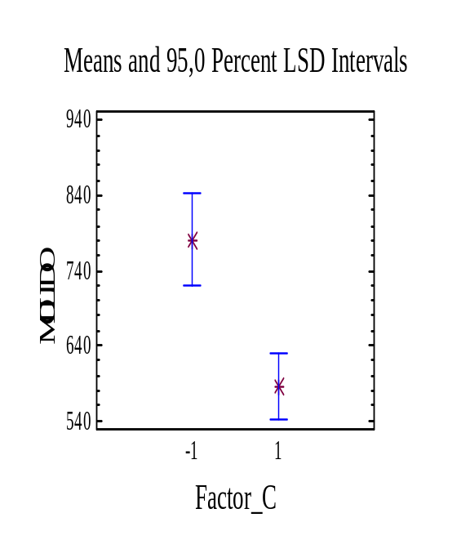
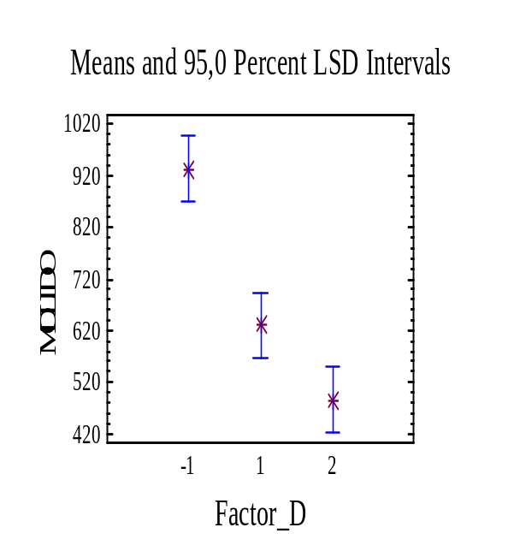
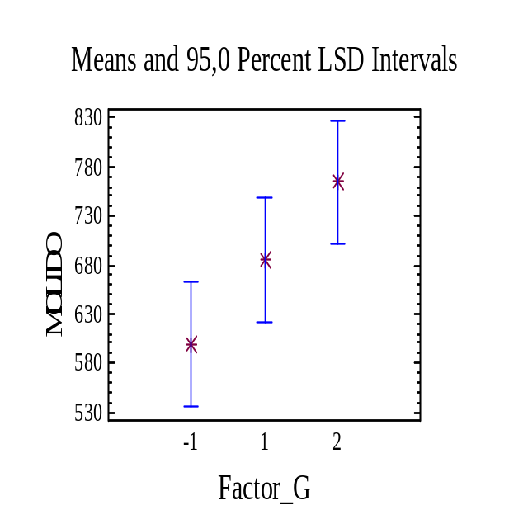
Optimum operative conditions to minimize: C (2) D (3) G (1)
Certain quadratic effect is observed in factor D
(it could be studied with multiple linear regression)
The effect of G is clearly linear (not quadratic) in the interval tested. Thus, if possible, it would be better to decrease even more the level of factor G.
74

